Slide 1
DTNPL ETB Test - TRR
조진호 (ETRI)
2020. 09. 03

Slide 2
Agenda
Objective
Test Matrix
Test Configuration
Test Schedule
Test Member
Document Status
TRS Summary
Test Equipment Status
Test FW & APS Status
Test ID & Method
Issue & Concerns
Near Term Activities

Slide 3
1. Objective
Test Objective :
  Verify proper operation of the DTNPL
DTNPL ETB Test
  Verify SOH Telemetry
  Verify Discrete Command (Reset TC)
  Verify Bi-level Telemetry (0.25Hz Heart Beat)
  Verify DTN Operation
    BP message
    File transfer using CFDP
    Video streaming using BSS

Slide 4
2. Test Matrix
DTNPL Test Matrix
Test |  | Requirement |  | ETB Test Activity(KPLO)
ID | Title | ID | Title | DC INT | ELEC. INT | RF INT. | Processor | Payload Logic | EPS Logic | TCS Logic | AOCS Logic | Fault Manag. | BUS OP. | EMC | End to End
DTN-010 | SOH telemetry | SSD-DPL-10060 | Health report |  |  |  |  | T
 |  | SSD-DPL-10070 | DTN status report
DTN-020 | Bi-level telemtry | SSD-DPL-10090 | Fault detection |  |  |  |  | T |  |  |  | T
DTN-030 | Reset command | SSD-DPL-10100 | Fault recovery |  |  |  |  | T |  |  |  | T
DTN-040 | Time setting | SSD-DPL-10080 | Time synchronization |  |  |  |  | T
DTN-050 | BPM single trip | SSD-DPL-10010 | DTN protocols |  |  |  |  | T
 |  | SSD-DPL-10020 | DTN user utilites
 |  | SSD-DPL-10030 | DTNPL modes
 |  | SSD-DPL-10040 | DTN end point mode
DTN-060 | CFDP single trip | SSD-DPL-10010 | DTN protocols |  |  |  |  | T
 |  | SSD-DPL-10020 | DTN user utilites
 |  | SSD-DPL-10030 | DTNPL modes
 |  | SSD-DPL-10040 | DTN end point mode
DTN-070 | BPM round trip | SSD-DPL-10010 | DTN protocols |  |  |  |  | T
 |  | SSD-DPL-10020 | DTN user utilites
 |  | SSD-DPL-10030 | DTNPL modes
 |  | SSD-DPL-10050 | DTN way point mode
DTN-080 | CFDP round trip | SSD-DPL-10010 | DTN protocols |  |  |  |  | T
 |  | SSD-DPL-10020 | DTN user utilites
 |  | SSD-DPL-10030 | DTNPL modes
 |  | SSD-DPL-10050 | DTN way point mode
DTN-090 | BSS downlink | SSD-DPL-10010 | DTN protocols |  |  |  |  | T
 |  | SSD-DPL-10020 | DTN user utilites
 |  | SSD-DPL-10030 | DTNPL modes
 |  | SSD-DPL-10040 | DTN end point mode

Slide 5
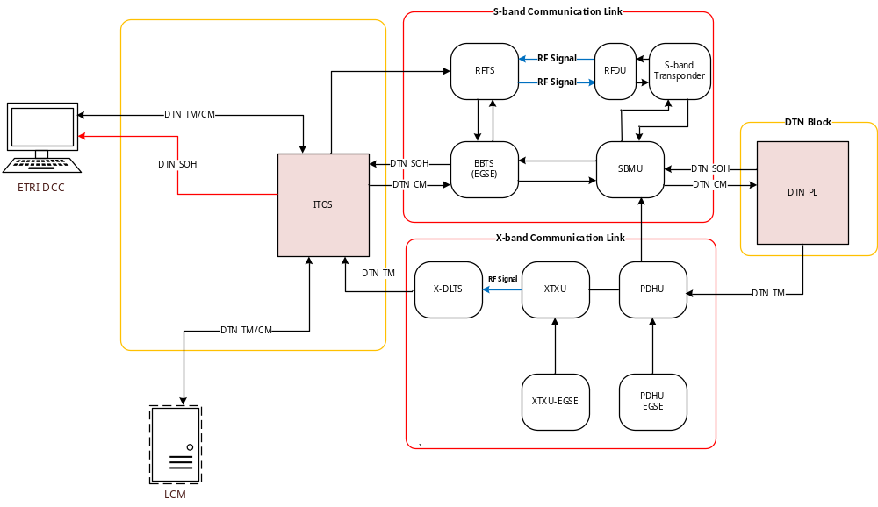
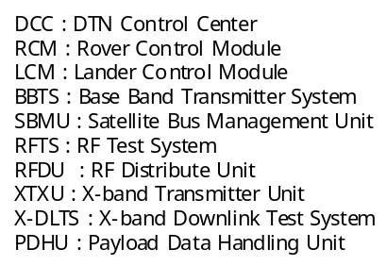
3. Test Configuration (1/2)
Step #01 – Logic Test
  Check DTN operation in the KPLO ETB
  ITOS without DTN nodes

Slide 6
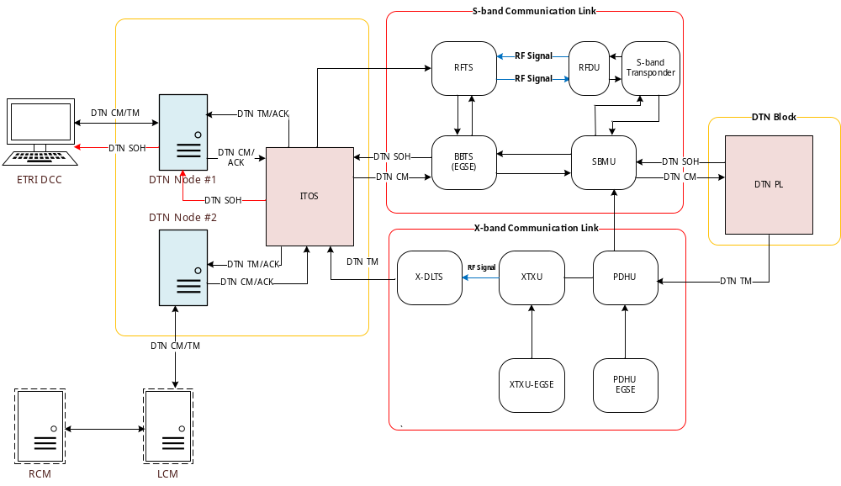
3. Test Configuration (2/2)
Step #02 – Logic Test
  Check DTN operation in the KPLO ETB
  ITOS with DTN nodes (DTN nodes #1 and #2)

Slide 7
4. Test Schedule
Step #01 Logic Test
  To be performed on Sep. 10~11
Step #02 Logic Test
  TBD

Slide 8
5. Test Member
DTNPL RLE (Responsible Leading Engineer)
  조진호(ETRI)
DTNPL TLE (Task Leading Engineer)
  이경락(ETRI)
DTNPL Test Engineer
  최상림(루미르), 김선구(루미르)
KPLO ETB Operator
  TBD

Slide 9
6. Documentation Status
Test Procedure
Document Title | CM Number | Released Date | Issue | Status
KPLO ETB DTNPL Test Procedure | KPLO-D0-550-212 | 2020.8.28 | D.01 | Prepared
Reference Document
Document Title | CM Number | Released Date | Issue | Status
KPLO ETB Test Plan | KPLO-D0-710-001 | - | F.00 | Prep.
KPLO Electrical System Interface Document | KPLO-SP-320-008 | 2018.09.31 | P.01 | Signed

Slide 10
7. TRS Summary
TRS Status
  ETB 인터페이스 시험 시 정상적으로 작동함을 확인 (‘20.8.19)
  ETB 시험을 통하여 재 검증 후 close 예정
TRS# | Departure | Cause | Status | Open Date | Close Date | Disposition | Actionee | Corrective Action
28 | DTNPL_CONFIG (sco 431)울 통해 CDSCRIPT2 명령을 전송하였으나 DTNPL로부터 PDHU로 데이터가 전송되지 않음 | MDMAUART 정의에 따라 DTNPL은 모든 command에 대해 ACK (OK check, 0x12)를 회신해야 하지만, DTNPL의 firmware가 해당 ACK를 전송하지 않음 | Open | 2020/04/28 |  | DTNPL의 모든 TLM을 확인하였으나 값이 모두 0이었으며, DTNPL command error counter(TDCMDERRCNT)가 주기적으로 증가하는 것을 확인함 DCSCRIPT2 명령을 전송하는 경우도 TDCMDERRCNT가 증가함을 확인함 DTNPL의 EGSE를 통하여 DTNPL이 CMD를 정상수신하지만 ACK를 전송하지 않는 것으로 확인됨 | ETRI

Slide 11
8. Test Equipment Status (1/2)
EGSE
MGSE
  None
NO. | ITEM | Validation Date | S/W version | Update date | Remarks
1 | DCC | NA | 1.0 | NA | Note PC
2 | LCM | NA | 1.0 | NA | Note PC
3 | RCM | NA | 1.0 | NA | Note PC
4 | ITOS
5 | BBTS

Slide 12
8. Test Equipment Status (2/2)
Test Aids & Accessories
No. | Name | Model No. | Ready status | Remark
1 | BOB & cables | DTNPL BOB | Ready | ETRI provide
2 | DVM | - | Ready | KARI provide
3 | ESD Test Aid | - | Ready
4 | Oscilloscope | - | Ready

Slide 13
9. Test SW & APS Status
FW & APS
Category | Name | Version & SCOA | Release Date | Remarks
DTN SW | ION | Ver. 3.6.1 | 2020.08.10
FW | SBC FW | Ver. 1.1.0 | 2020.08.10
OS | RTEMS | Ver. 4.11 | NA
APS | ETB_DTNPL_11.APS ETB_DTNPL_21.APS | Ver. 01 NA | 2020.08.28 NA | Step #01 Step #02

Slide 14
10. Test ID & Method (1/5)
Title | SOH telemetry
Ref | DTN-010
APS | TBD
Purpose | Check DTNPL SOH telemetry
Criteria of success | DTNPL SOH telemetry to be reported well.
Test method/facility | - ITOS send TM request command to the DTNPL - ITOS check SOH telemetry from DTNPL - DCC check SOH telemetry from the ITOS
Configuration/ Periods to be tested | Refer to Figure in page 6-7
Test Procedures | KPLO-D0-550-450
Test constraints | None
Result report | As-run procedure
Title | Bi-level telemetry
Ref | DTN-020
APS | TBD
Purpose | Check DTNPL bi-level telemetry is working
Criteria of success | DTNPL shall output 0.25Hz heart beat signal (rectanglar wave) during nominal condition.
Test method/facility | SBMU monitor DTNPL heart beat signal (bi-level TM)
Configuration/ Periods to be tested | Refer to Figure in page 6-7
Test Procedures | KPLO-D0-550-450
Test constraints | None
Result report | As-run procedure

Slide 15
10. Test ID & Method (2/5)
Title | Reset command
Ref | DTN-030
APS
Purpose | Check DTNPL reset function
Criteria of success | DTNPL to be re-initialized by the bi-level command
Test method/facility | - ITOS Send reset command to DTNPL - Check if DTNPL was initialized
Configuration/ Periods to be tested | Refer to Figure in page 6-7
Test Procedures | KPLO-D0-550-450
Test constraints | None
Result report | As-run procedure
Title | Time setting
Ref | DTN-040
APS
Purpose | Check if DTNPL time is setted by the command
Criteria of success | DTNPL time to be updated by the command
Test method/facility | - ITOS send time set command to DTNPL - Check DTNPL time is updated by the command
Configuration/ Periods to be tested | Refer to Figure in page 6-7
Test Procedures | KPLO-D0-550-450
Test constraints | None
Result report | As-run procedure

Slide 16
10. Test ID & Method (3/5)
Title | BPM single trip
Ref | DTN-050
APS
Purpose | Check if DTNPL relay BP message in single trip path
Criteria of success | The BP message to be delivered between DCC and DTNPL
Test method/facility | - Send BP message from DCC to DTNPL - Check BP message was returned to DCC through DTNPL
Configuration/ Periods to be tested | Refer to Figure in page 6-7
Test Procedures | KPLO-D0-550-450
Test constraints | None
Result report | As-run procedure
Title | CFDP single trip
Ref | DTN-060
APS
Purpose | Check if DTNPL receive or transmit file using CFDP in single trip path
Criteria of success | Checksum value of transmit file and receive file to be same
Test method/facility | - Send test file from DCC to DTNPL using CFDP - Check checksum vale of TX and RX file is same - Send test file from DTNPL to DCC using CFDP - Check checksum vale of TX and RX file is same
Configuration/ Periods to be tested | Refer to Figure in page 6-7
Test Procedures | KPLO-D0-550-450
Test constraints | None
Result report | As-run procedure

Slide 17
10. Test ID & Method (4/5)
Title | BPM round trip
Ref | DTN-070
APS
Purpose | Check if DTNPL relay BP message in round trip path
Criteria of success | The BP message to be delivered between DCC and LCM through DTNPL
Test method/facility | - Send BP message from DCC to LCM through DTNPL - Check BP message was arrived at the LCM - Send BP message from LCM to DCC through DTNPL - Check BP message was arrived at the DCC
Configuration/ Periods to be tested | Refer to Figure in page 6-7
Test Procedures | KPLO-D0-550-450
Test constraints | None
Result report | As-run procedure
Title | CFDP round trip
Ref | DTN-080
APS
Purpose | Check if DTNPL relay file transfer in round trip path
Criteria of success | Checksum value of transmit file and receive file to be same.
Test method/facility | - Send test file from DCC to LCM through DTNPL using CFDP - Check checksum vale of TX and RX file is same - Send test file from LCM to DCC through DTNPL using CFDP - Check checksum vale of TX and RX file is same
Configuration/ Periods to be tested | Refer to Figure in page 6-7
Test Procedures | KPLO-D0-550-450
Test constraints | None
Result report | As-run procedure

Slide 18
10. Test ID & Method (5/5)
Title | BSS downlink
Ref | DTN-090
APS
Purpose | Check if DTNPL streaming video file using BSS
Criteria of success | Video file to be streamed from the DTNPL to be displayed at the DCC
Test method/facility | - DCC send BSS start command to DTNPL - DTNPL start video file streaming - Streamed video to be displayed on the DCC
Configuration/ Periods to be tested | Refer to Figure in page 6-7
Test Procedures | KPLO-D0-550-450
Test constraints | None
Result report | As-run procedure

Slide 19
11. Issues and Concerns
Step #01 Logic Test
  Tests will be performed without KARI DTN nodes
Step #02 Logic Test
  Depends on KARI DTN nodes schedule

Slide 20
12. Near Term Activities
Step #01 Interface Test
  Scheduled on Sep. 10 ~ 11
Step #02 Logic Test
  TBD

